Slide 1
Lecture 3
Display Devices Continued

Slide 2
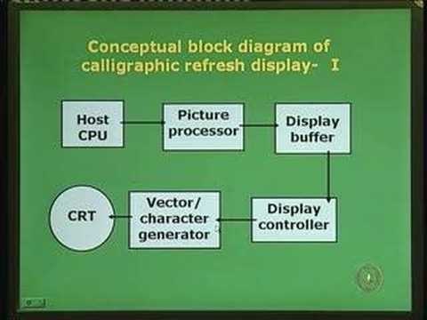

Slide 3
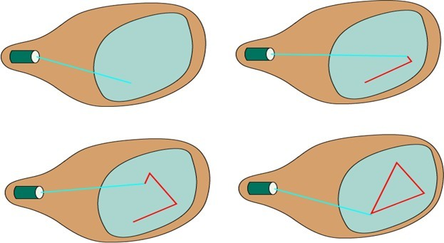
Random Scan Display:

Slide 4
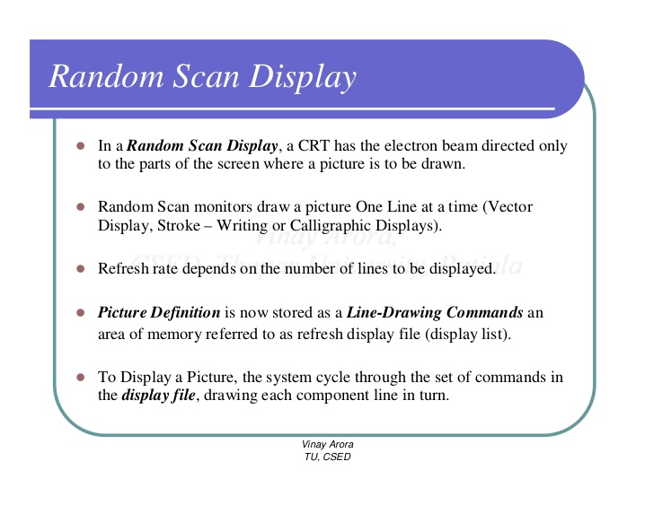

Slide 5
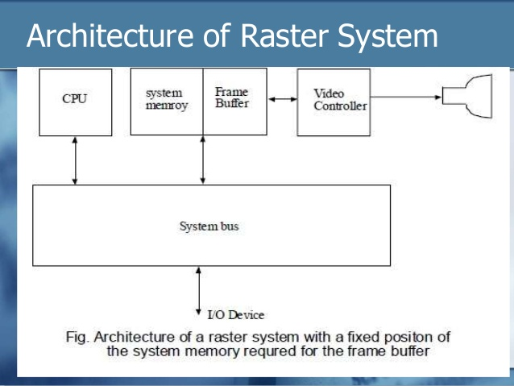

Slide 6
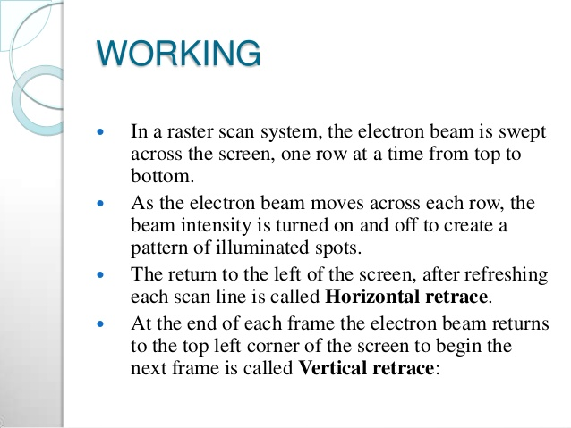

Slide 7
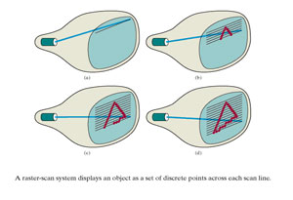

Slide 8
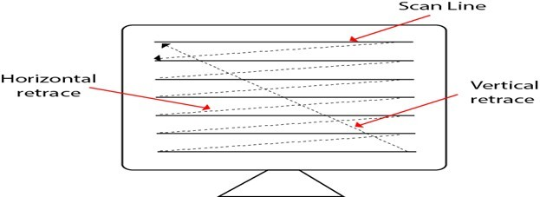
Raster Scan Display:

Slide 9
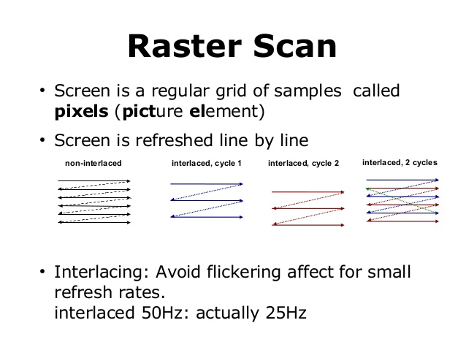

Slide 10
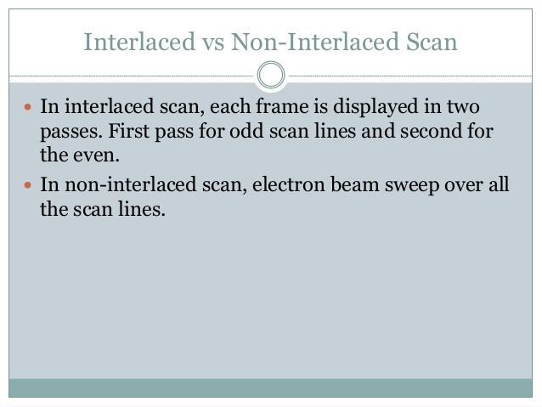

Slide 11
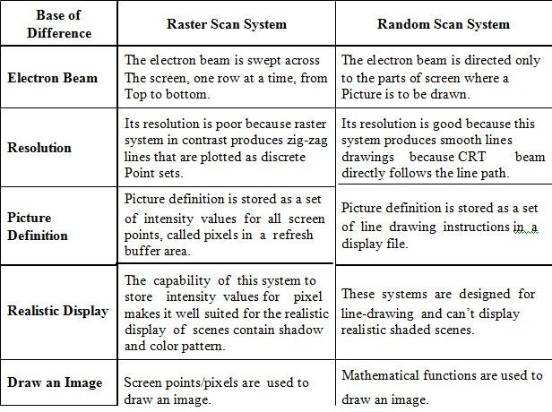
Difference Between Raster and Random Scan Systems

Slide 12
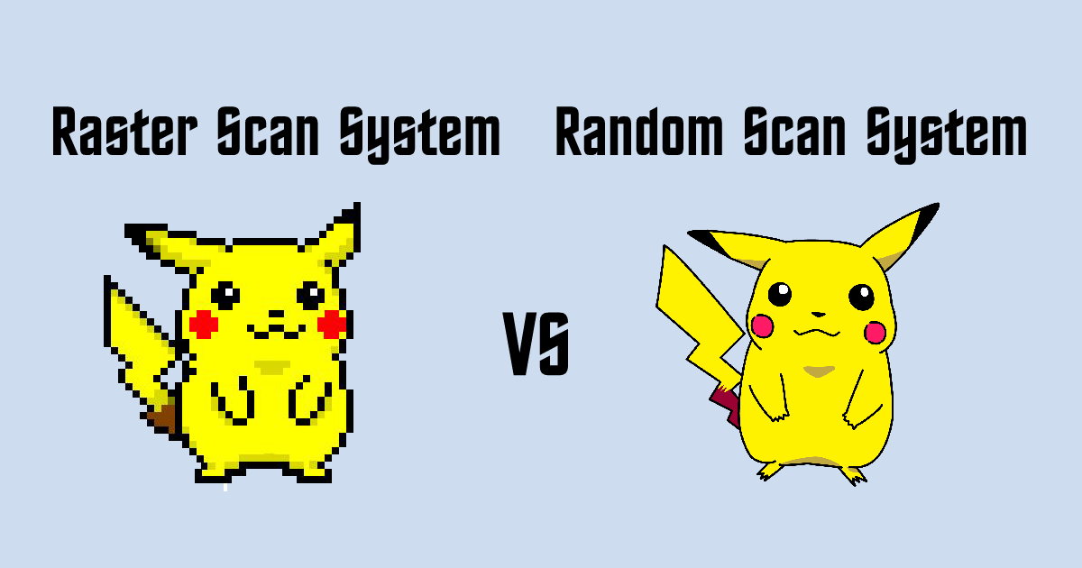

Slide 13
CONCLUSION
In this lecture we studied the architecture and working of raster and random scan display systems and the difference between them.

Slide 14
SHORT QUESTIONS:
Q.1. What is the use of anti-aliasing in certain graphic programs?
Q.2. What type of graphics card offers the greatest resolution?
Q.3. What colors is not used to generate the color on a color monitor?
Q.4. Name of four file formats in raster graphics.
Q.5. Function of Raster scans display
Q.6. What do you mean by horizontal retrace and vertical retrace?

Slide 15
LONG QUESTIONS:
Write short note on: Anti-aliasing technique? (RTU 2014)
Explain Raster Scan System. What is scan conversion? Explain raster scan system with help of example. (RTU 2013)
a) Differentiate b/w Raster & random scan display devices. ? (RTU 2016)
Explain beam penetration method.
What is importance of 8-way symmetry in scan conversion of circle.
Explain various application areas of computer graphics. Differentiate beam penetration method of colored CRT with shadow mask method.(RTU 2017).
Write short notes on: (RTU 2018)
–Cathode Ray Tube
–Anti-aliasing Techniques
–Shadow mask Technique
- Beam Penetration Technique
What is scan conversion? Explain Raster Scan system with the help of Block diagram? (RTU 2015,18)
Explain the working of Direct View Storage Tube with help of labeled diagram.

